Slide 1
AI on the Edge
Deploying Models Outside the Data Center
Notes:
I’m Mike Lanzetta from Microsoft and I’m here to talk to you today about some general DevOps, IoT Ops, and ML Ops principles, and my team’s experience in trying to apply these to real-world projects. I’m really excited to be able to finally attend one of these meetings, welcome to Microsoft!

Slide 2
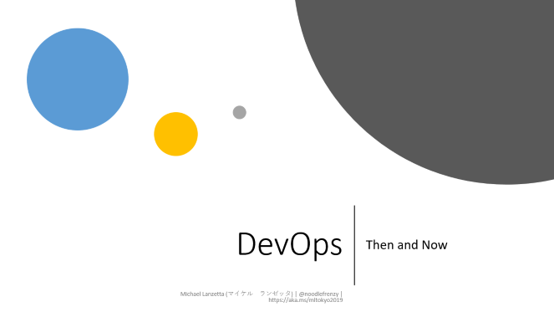
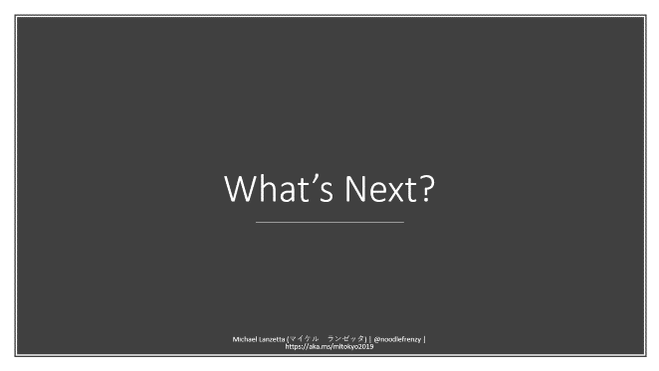
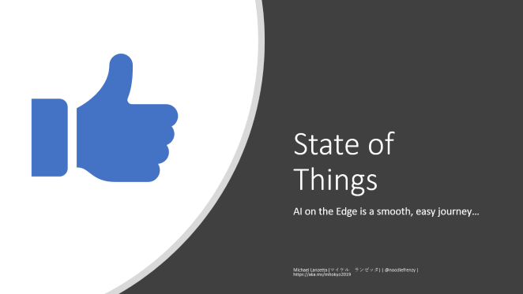
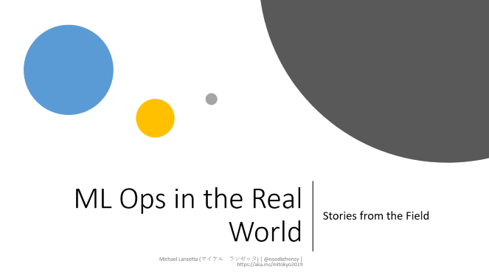
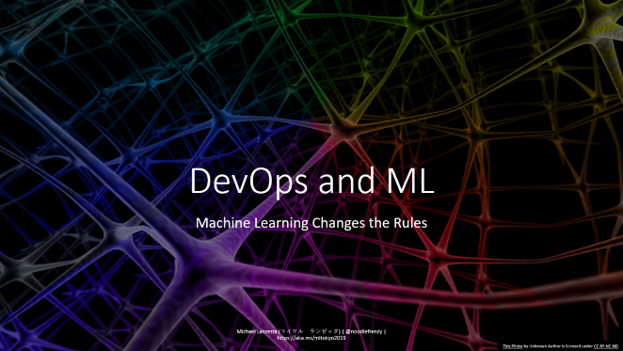
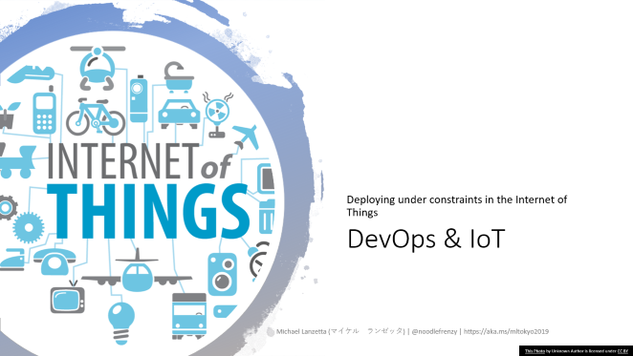
Agenda

Slide 3

State of Things
AI on the Edge is a smooth, easy journey…
Notes:
So where are we today? As we all know… AI on the Edge is a smooth, easy journey…

Slide 4
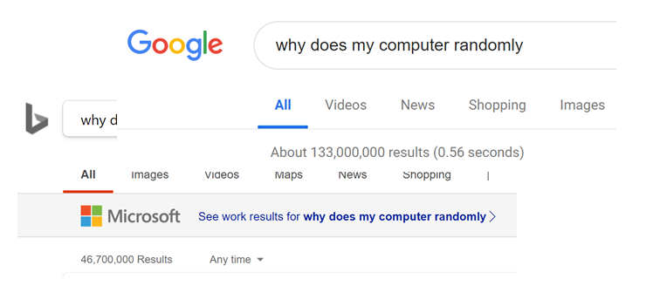
Computers are Deterministic
Notes:
Computers are deterministic, never doing things randomly, and always able to explain their actions.

Slide 5
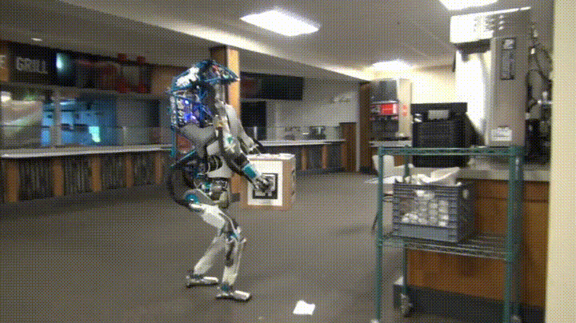
AI is State of the Art
Notes:
Artificial Intelligence is producing new state-of-the-art results every day, with no setbacks.
Cite: Giphy via r/shittyrobots

Slide 6
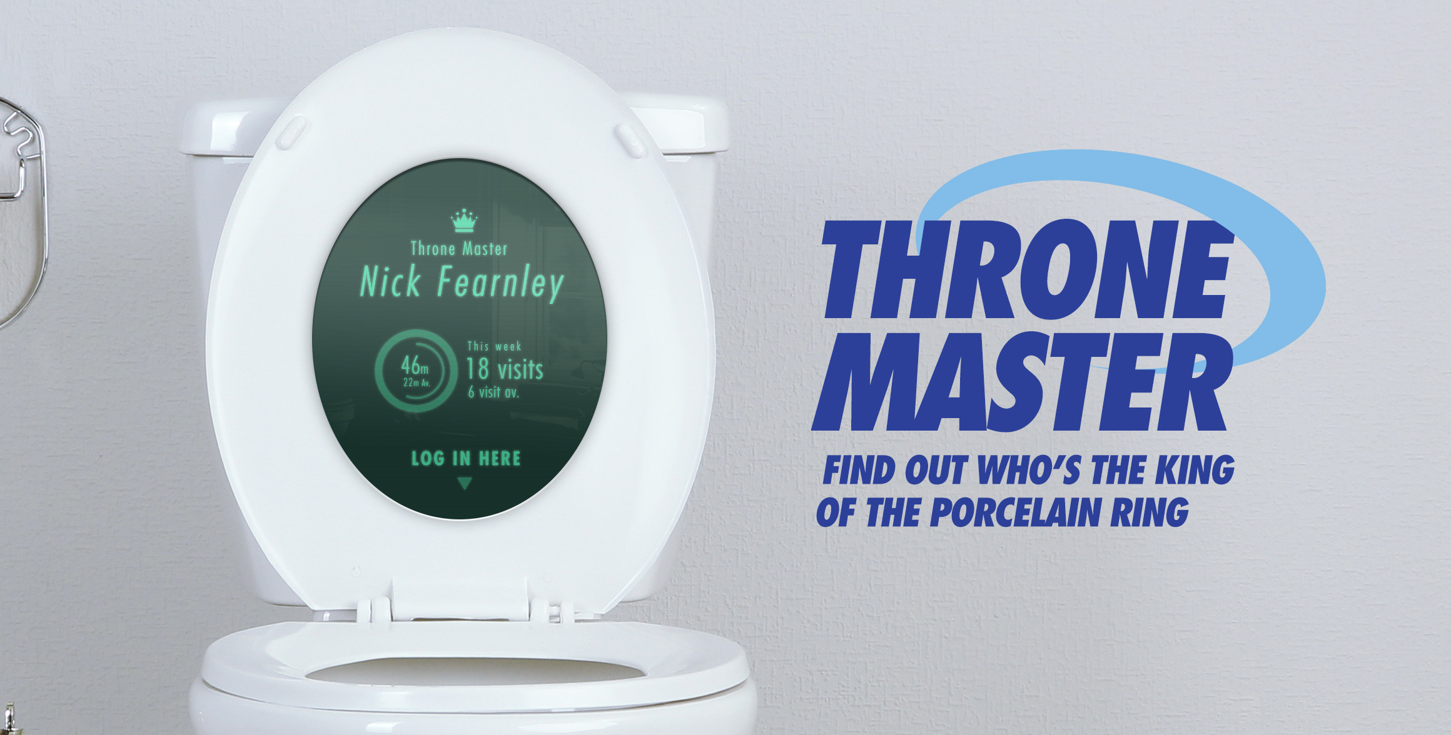
Edge Devices are Ever More Powerful
Notes:
Edge devices are growing ever more powerful and useful.
Cite: https://www.bradbox.com/blog/tag/analytics/

Slide 7

Everything Works Seamlessly Together
Notes:
In short, everything works seamlessly together to easily provide smart edge solutions for the future!
Obviously I’m kidding. The situation is far more complex. During the talk I’ll go through some of the reasons for DevOps and the basics of current DevOps solutions, then delve into how those change when you complicate things with ML, and edge deployments. This is only an hour talk, so don’t expect deep dives, as each of these areas can easily be a day-long course or more.

Slide 8
DevOps
Then and Now
Notes:
So what is DevOps, where did it come from, and where is it now?

Slide 9
DevOps Defined
Wikipedia defines DevOps as
“Academics and practitioners have not developed a unique definition for the term "DevOps."[a][b][c][d]”
When I think of DevOps, I think of these four key components:
Repeatable, Reliable Deployments
Dependency Control
Systems as Artifacts
Continuous Integration and Deployment (CI/CD)
Feel free to define your own DevOps
Notes:
Wikipedia defines DevOps as … well, they don’t really have a definition.
When I think of DevOps, I think of four key components: repeatable, reliable deployments; dependency control (knowing what your external dependencies are, and their versions); systems as artifacts (the ability to “source control” your infrastructure); and continuous integration and deployment or CI/CD (ensuring all of the above continues to work as your system changes).
However, this is just my definition – you and your organization might have your own, but it should share most if not all of these goals.

Slide 10

DevOps: A Brief History
“Metal” begets VMs
Hudson begets Jenkins
Chef & Puppet
VMs beget Containers
Vagrant & Docker
Mesos, Swarm, Kubernetes
Notes:
DevOps evolved in an attempt to tackle the points I outlined in the previous slide. Deploying onto “bare metal” servers made it tough to control versions and specs as systems evolved over time in your data center. VMs came about in an effort to abstract away some of those ambiguities. Systems like Hudson and CruiseControl made it easier to make sure code you were checking in still built and passed all of its tests, and evolved into Jenkins becoming even more powerful. Chef and Puppet surfaced, providing the ability to orchestrate the deployment of complex, multi-component systems from raw VMs into “desired state”.
Eventually VMs were abstracted away themselves with “containerization”, allowing people to define their systems with simple configuration files that could inherit from others, allowing DevOps Engineers to easily build on the work of others, and check in entire system configurations that were nothing more than a few lines in a YAML file.
These containers allowed engineers to build large distributed clusters of containers easily with technology like Mesos, Docker Swarm, and Kubernetes, and YAML files ruled the land.

Slide 11
Current DevOps: Docker All The Things
Git
Systems as Artifacts
Docker
Repeatable Deployments
Dependency Control
Kubernetes
Scalability
Reliability
Easier Integration CI/CD
Microservices
Easier Dependency Control
Easier Component CI/CD
CI/CD
Many options – we use Azure DevOps
… and Jenkins
… and even Travis
Notes:
Now the DevOps world is starting to stabilize around a few core technologies.
- Git now reigns supreme for source code control, making it easier to store your systems as artifacts and pull entire systems from others who have done the work before you.
Containerization is king, and Docker is the container technology of choice.
For scaling out, people have cohered around Kubernetes.
All of these technologies make it easy to componentize your code into small, easily testable APIs, leading to most solutions becoming the collaboration of many microservices. These make it easier to manage your dependencies, and are small enough to make component testing easy.
Managing all of these is made easier with CI/CD pipelines, allowing merges to master to trigger registration of new Docker containers and deployment of entire clusters for testing, staging, and production. My team typically uses Azure DevOps (but sometimes Jenkins, sometimes even Travis). The important thing is to have a CI/CD tool and to use it – choose the one that works for you.

Slide 12

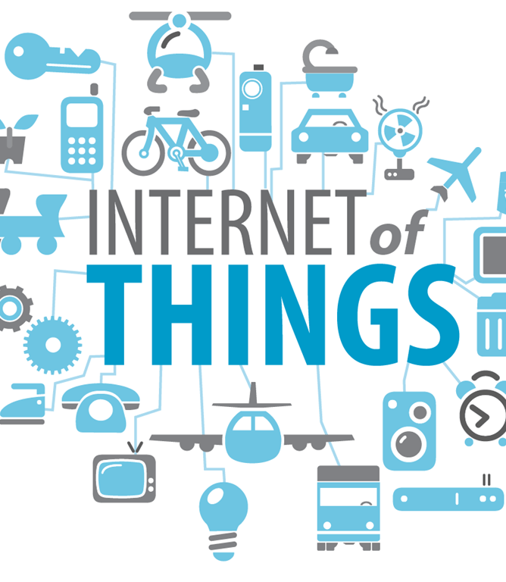
DevOps & IoT
Deploying under constraints in the Internet of Things
This Photo by Unknown Author is licensed under CC BY
Notes:
How does DevOps change in the face of IoT and Edge development?

Slide 13

DevOps for IoT
“Just Deploy Docker”
Constrained memory
Minimal storage
Intermittent network
Deployment landscape is much more complex
Cloud-supported
“Heavy” Edge
“Light” Edge
Notes:
The standard DevOps answer of “just deploy Docker containers” doesn’t always work in IoT. Often you’re operating with limited RAM, minimal on-board storage, and intermittent network connectivity. DevOps testing in these scenarios is also complicated, as assuming the “sunny day” scenario in IoT is far less likely to be the truth – sometimes literally for devices that are deployed outside. Don’t get me wrong – Docker is still usually the right answer – but you need to carefully control the size of your containers both on-disk and in-RAM to ensure they’ll work in your targeted scenario.
In addition, the deployment landscape is much more complicated. You can have “heavy” edge devices – actual on-premise computers, sometimes with GPUs, that may suffer from similar IoT issues. Or “light” edge devices – what we typically think of when we think about IoT – and within those is a spectrum from the Raspberry Pi to the ThroneMaster.

Slide 14
Edge Deployment
Light and Heavy
 | Cloud: Azure | Heavy Edge |  |  |  | Light Edge
Description | An Azure host that spans from CPU to GPU and FPGA VMs | A server with slots to insert CPUs, GPUs, and FPGAs or a X64 or ARM system that needs to be plugged in to work |  |  |  | A Sensor with a SOC (ARM CPU, NNA, MCU) and memory that can operate on batteries
Example | DSVM / ACI / AKS / Batch AI | - DataBox Edge - HPE Azure Stack | DataBox Edge | Industrial PC | -Video Gateway -DVR | -Mobile Phones -VAIDK | -Mobile Phones -IP Cameras | -Azure Sphere - Appliances
What runs the model | CPU,GPU or FPGA | CPU,GPU or FPGA | CPU, GPU | x64 CPU | Multi-ARM CPU | Hw accelerated NNA | CPU/GPU | MCU
Cloud Consistent
Hybrid Server
PC class devices
Smart Sensors + Ambient AI
Servers
Gateway
Sensors
Notes:
This landscape is quite varied, and for ML projects it can have a serious impact on where your model runs and what sort of capabilities you’ll be able to support.
So with that let’s talk about DevOps and ML…

Slide 15
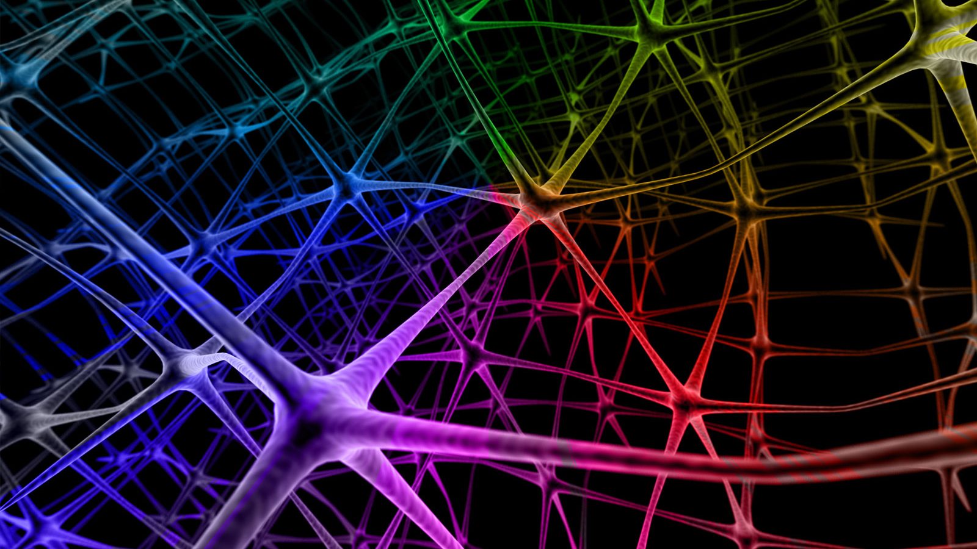
DevOps and ML
Machine Learning Changes the Rules
This Photo by Unknown Author is licensed under CC BY-NC-ND
Notes:
Here’s the legally required “working brain” picture, since I didn’t want to re-use the “pondering robot” option.
ML changes DevOps in some fundamental ways. Just as “testing” in ML projects is fundamentally different than in regular software, so is managing DevOps. Remember one of the goals of DevOps is reliable, repeatable deployments – how does that change when your “code” is probabilistic? I’ll talk about some of the challenges you face when integrating ML into your DevOps process.

Slide 16
DevOps For Machine Learning
ML Ops
Data Ops
Notes:
You run into two large new challenges with ML in DevOps. First, what we might call ML Ops.

Slide 17
DevOps For Machine Learning
ML Ops
Models can be large
Monitoring model performance
“Flighting”, or A/B Testing
Quantization, compression
Notes:
This consists of things like dealing with the fact that models are large, often much larger than the code artifacts that you might be deploying, and they often need to be deployed into low-resource environments. So you need to start considering model quantization and compression – how do you make your model smaller in footprint without sacrificing (too much) performance. There are a few tools for this – we collaborate with other partners on a format called ONNX that abstracts between models and the hardware they deploy on, and allows for model quantization and compression easily. ELL is another tool we have for that purpose. TensorFlow has their own method with TF Lite.
Once the model is deployed, monitoring is more challenging than in a regular software app. You not only need to know “is my app failing”, but also “is my model prediction failing” which is a much more challenging task. That’s not even mentioning things like concept drift, which I’ll discuss at the end. You also want to be able to “flight” new models, determining which one performs better in production before rolling it out to all users. Once again, “performs better” is tough to measure in the wild, and needs to be carefully considered. For models with direct user feedback, online learning solutions like our Multi-world decision testing service, Vowpal Wabbit, and others might be the right choice. For others, you need to carefully consider your metrics and how you evaluate them “in the wild”.

Slide 18
DevOps For Machine Learning
ML Ops
Data Ops
Notes:
Second, with data, there are other concerns.

Slide 19
DevOps For Machine Learning
Data Ops
Scrubbing
GDPR and You
Lineage tracking
Notes:
You need to make sure that your model doesn’t internalize your training data, allowing it to “leak” under repeated model calls or if the model itself is compromised. If you’re concerned about user privacy, you need to make sure you “scrub” your data of PII before even getting to the training stage. If you’re working in a GDPR country, you’ll also need to track data lineage – if someone requests their data removed, you might need to remove it not only from all training/validation/test sets, but also re-train models that had used it.

Slide 20
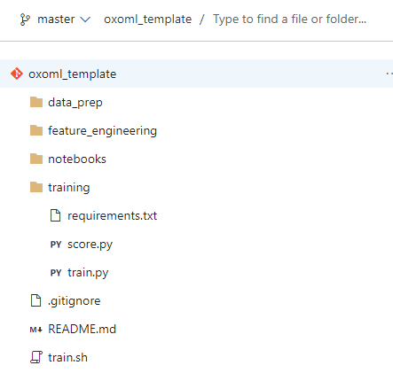
Things to Version
Source Control
Track changes in code (and configuration) over time, integrate work, reproducibility and collaboration.
Dataset Versioning
Training data plays an important role in the quality of the software build. Hence, versioning of data is required for reproduceability.
Model Versioning
Version trained models in relation to code and training data for traceability.
Experiment Tracking
Version model experiment runs to understand which code, data and e.g. selected features led to what output and performance, and allow for reproducibility.
Notes:
In ML projects, versioning becomes even more important than in regular DevOps projects. As with regular projects, you need to track changes in your source – and remember because of DevOps, your “source” also contains your infrastructure. With ML, though, you need to version datasets – ideally with their data dictionary or catalog – so you can track changes to the dataset over time. You also need to version your trained models, with information that allows you to trace them back to the source code version and dataset version used to produce them. You also will likely need to version any random seeds you might have used in training or in the train/validation/test split logic. Finally you need to version your experiments, so it’s easy to track your project’s progress over time and you don’t need to revisit feature engineering you may have done once new people (or you in six months when you’ve forgotten) come onto the project.

Slide 21
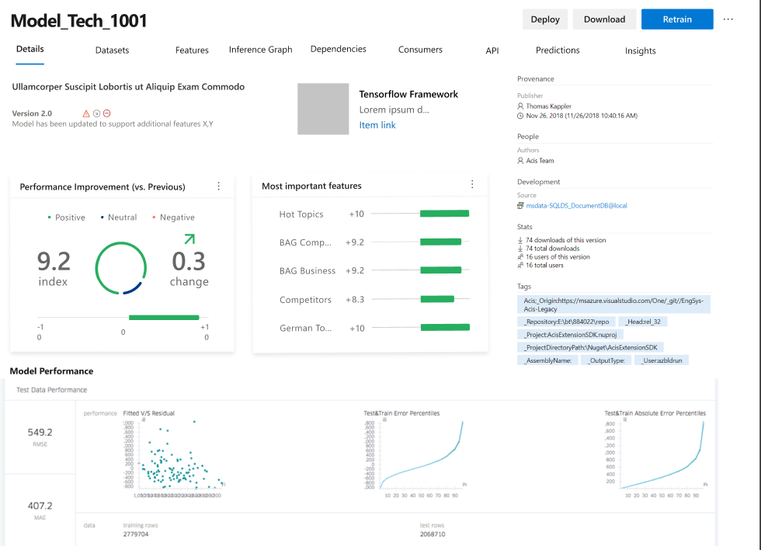
Model Versioning & Storage
Provide a consistent way to discover, store, track & share models
Provide a consistent model metadata format
Track where a model came from
which data
which experiment / previous model(s)
where’s the code / notebook
Was it converted / quantized?
Track where model is running & model health
Control who has access to what models
Private / compliant data
Notes:
Any good ML DevOps pipeline should be able to store this information as part of the ML DevOps process. You should be able to track experiments, compare performance within and across them, share them among users, track models back to source data and code. You should be able to turn models into shippable artifacts, and then track where they’re running and whether they’re healthy.
In practice we’ve mainly used AzureML, Databricks, and MLFlow for these purposes, or rolled our own. However, this field is becoming crowded – you should evaluate the available tools (which I’m sure will be different next week) and choose one that suits you.

Slide 22
ML Ops in the Real World
Stories from the Field
Notes:
So how does this work out in the real world? We’ve been doing this for a while, which means two things. First, we were doing it before there were tools to help us. Second, we’ve seen some weird scenarios.

Slide 23
My Team In Brief
Strategic Partners
Microsoft’s Largest Customers
But… sometimes not
Or… sometimes on strange projects
Code-With
Code side-by-side with their developers
Same for the data science side
Technical Depth
IoT, DevOps, Data at Scale, Blockchain, Augmented Reality
And, of course, ML and DL
Cross-Domain ML Expertise
NLP, CV, Audio, Time-series
Necessarily this means lack of depth for the team
We have specialists in certain areas
We can supplement with Microsoft Research
Long-term Azure Enablement
Allows us to work on non/low-Azure engagements
Do good work, establish confidence, report feedback
Notes:
First a little about my team. My team at Microsoft works with some of our largest enterprise customers on projects where Microsoft doesn’t have an out-of-the-box solution. We code side-by-side with their developers and … data-science side-by-side with their data scientists. We have experience across a wide variety of technologies, including my specific team which has cross-domain ML experience. Our goal is to use relatively short engagements to unlock longer-term Azure commitment not only on the part of the customer, but by open sourcing our solutions when we can and talking about them (and giving feedback to product teams), on the part of others as well. As such, we can even work in areas that don’t seem like “high cloud revenue”, since it helps everyone grow. I’ll talk about a few of the projects we’ve done in the “AI on the Edge” space and how we dealt with some of these DevOps issues.

Slide 24
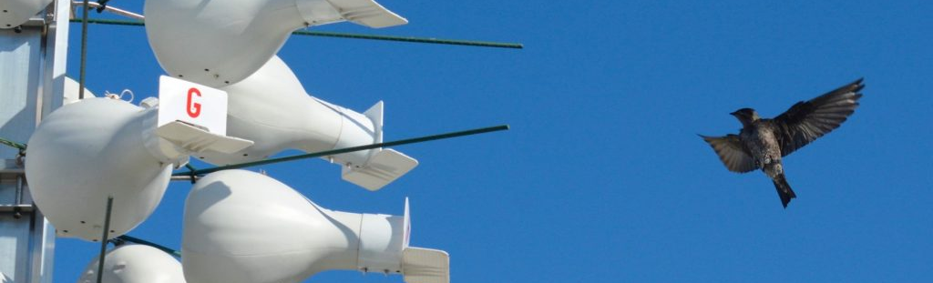
Data Leaving the Nest
Disney and our team
Monitor the purple martin
In-nest / on-nest
Custom enclosures
Monitoring
Network issues
Model compression
Pull deployments
Notes:
First, we worked on a project with Disney’s Emerging Technologies division to instrument bird’s nests in their Animal Kingdom park in Florida. The Purple Martin is a bird that has long used humans as the source of their nesting grounds – first with hanging gourds by the Native Americans, and now with artificial gourd-like nests in groups. Disney had been monitoring these birds by hand, which was time-consuming and stressful for the birds. We came in and helped instrument the nests, with in-nest and on-nest enclosures and a camera rig to monitor the whole emplacement. The solution was complicated because the nests were out in the open in Florida, so subject to extreme heat, and even more extreme weather. The network was intermittent on a good day. The enclosures needed to be self-sufficient, and avoid harming the birds even when we couldn’t see what was going on.

Slide 25
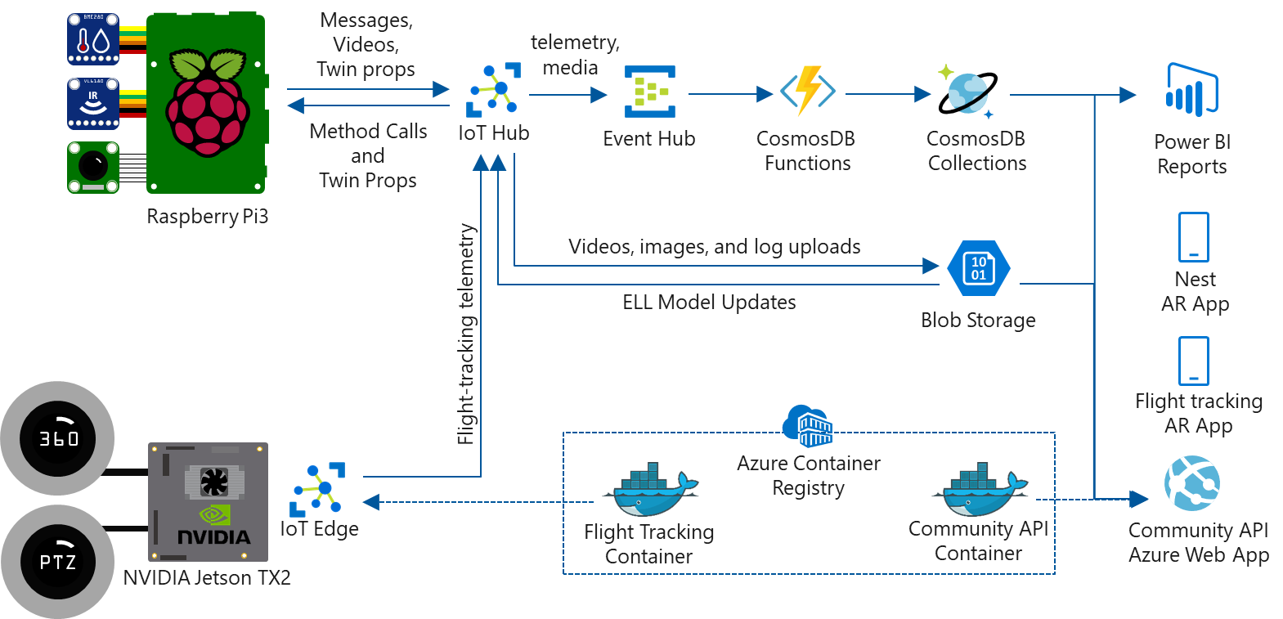
Notes:
I’m not going to go into detail here, but I just wanted to point out a few pieces. First, we had in-nest and on-nest enclosures with Raspberry Pis with sensor gear. These would upload data to Azure IoT Hub, and we could process it into reports. We could deploy models onto the Pi to do interesting work and try and gather useful data. Additionally, we had a Jetson board attached to a 360 degree and pan-tilt-zoom camera setup that allowed us to track objects with the 360 camera and use the PTZ to take close-ups and determine which objects were purple martins. This would let us get flight patterns and potentially start understanding purple martin behavior around the nest. Models needed to be light to run on the board, so we invested a fair amount of time using ELL for model compression. Much of the Azure IoT Edge infrastructure did not yet exist, so we built a framework that allowed devices to ping back and determine if they needed to update themselves – if so, they would do a git pull to get the latest code, grab the latest model from Azure Blob storage, and restart themselves.

Slide 26
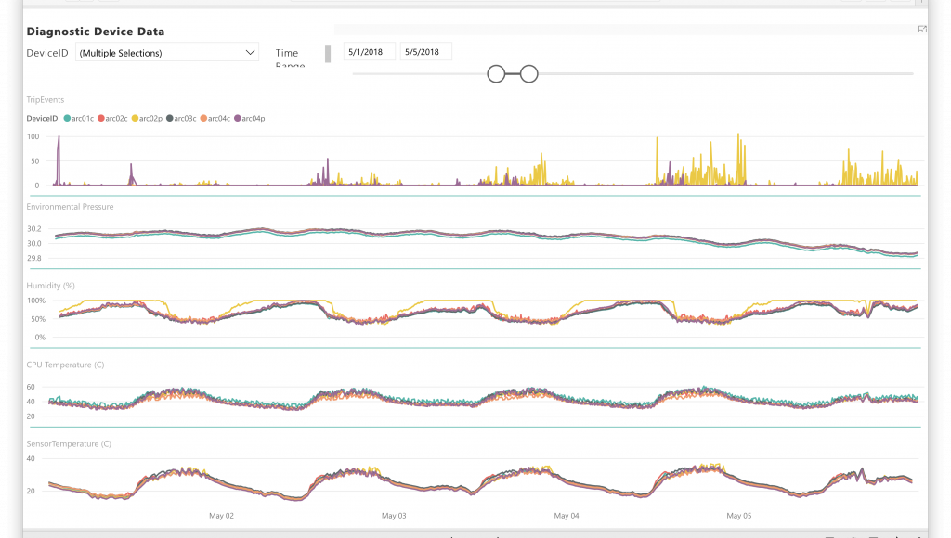
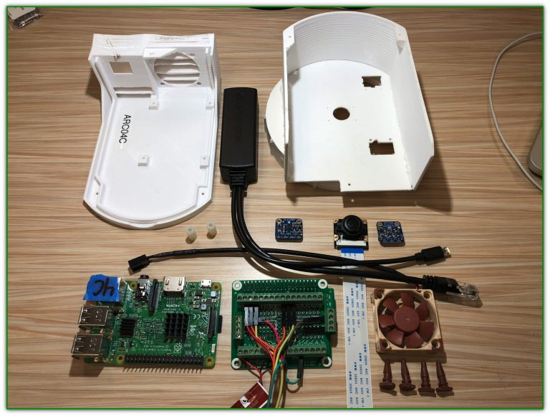
3D Printing and Power BI
Nests equipped with HD infrared cameras
Sensors track temperature, humidity, etc.
Temperature can trigger the camera to turn off, to avoid harming the birds
Camera spools footage in rolling buffer
Intermittently pulls key frames
Model determines if they’re “interesting”
Video clip uploaded
Notes:
The devices themselves were custom 3D printed to allow them to work in these constrained field environments. The in-nest devices used infrared cameras to track bird and egg development, with sensors telling the camera to turn off if the temperature got too high. The camera would spool data into a rolling buffer, and the in-nest model would determine whether a frame was “interesting” by classifying it into one of several categories and determining how confident it was that it was in an interesting category. If it was, it would upload the latest video buffer to the cloud where it could be analyzed by an even more detailed neural model – the ornithologist.

Slide 27
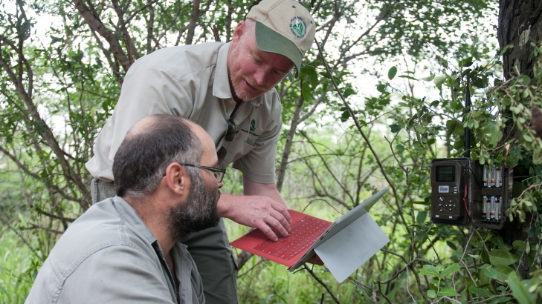
Deploying in the Wild
Work with Peace Parks to prevent rhino poaching
Easiest way to field-deploy a model… Don’t
Inference in the cloud
Allows cohesive solution at expense of latency
Notes:
Keeping on the environmental journey, we recently worked on a project with an organization called Peace Parks to help them prevent rhino poaching in South Africa. This was part of our overall AI for Earth initiative and not really meant to drive revenue, as rhinos aren’t large cloud consumers. The Peace Parks crew learned a lot from our Disney work and realized that the easiest way to make sure your field-deployed model was up to date was to … not deploy it to the field. I wanted to bring this project up because this is a totally viable option. You shouldn’t feel compelled to force your model to run on the edge if the situation doesn’t demand it. In this case, they had the connectivity, and they had the time. They wanted to analyze frames and video from all over the park, and use it to help improve their model, understand how the poachers work, and devise better counter strategies. Only once that was done have they started considering field deployment.

Slide 28

Toughening Up Continuous Integration
On-device app/model integration
The many meanings of performance
ONNX, or lies we tell ourselves
Notes:
Panasonic wanted to build an ML-backed application for their Toughpad line of … tough pads … in order to determine the capabilities and limits of the machine, figure out their technological roadblocks, and demonstrate that they could increase productivity in the field even with relatively simple solutions. We worked with them to design and develop an application that would allow field engineers to increase the productivity of their site visits by auto-detecting and auto-measuring aspects of the site that typically required complicated manual measurement.

Slide 29

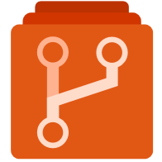

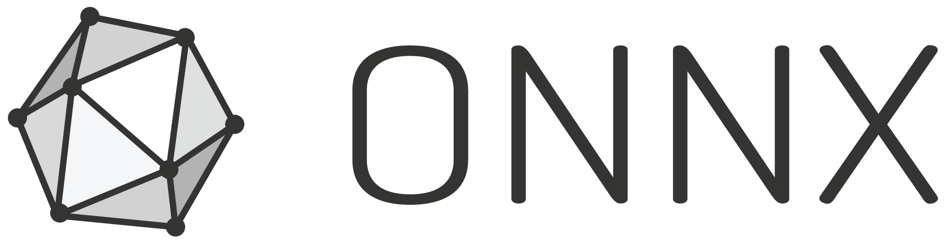




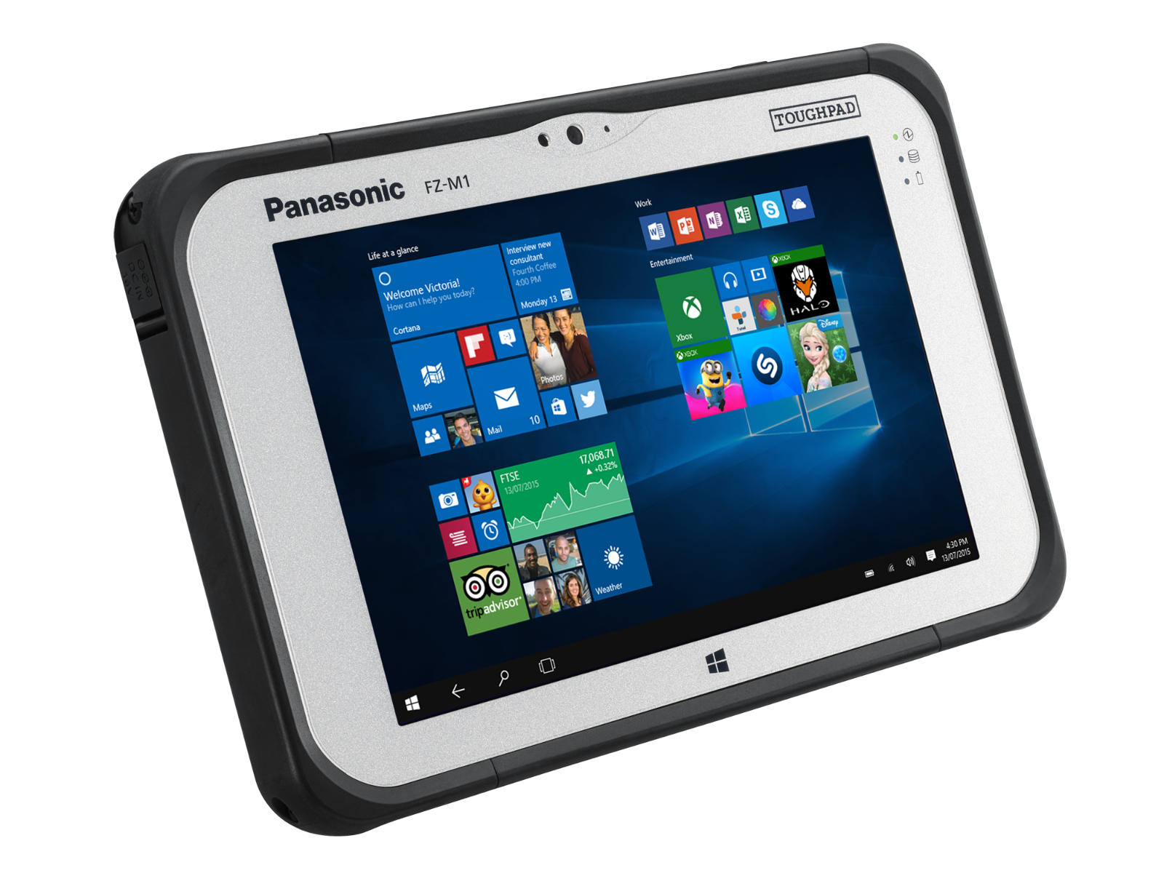

MLOps Using Azure ML
Azure Pipelines
Run linter
Run tests
Kick off
Training &
Evaluation
Compare metric
on the best model
CD for on-device deployment
Azure Git Repository
On-device
AML
Datastore
AML Compute
Azure Blob Storage
Field Engineer
C# Native App (WPF)
C# Native App (WPF)
Annotator
AML Run
History
AML Model
Repository
Azure ML Service
Notes:
We used Azure ML to manage our model training, performance tracking, and drive decisions in our CI/CD pipeline. In order to ensure that the model would work, and perform adequately, on the device, we integrated a Toughpad into the CI pipeline. During the model training pipeline, the trained model first has its accuracy measured, and if it passes that test it then gets auto-deployed onto a Toughpad and we ensure predictions meet the SLA before we mark it as “production ready”. We initially were going to be using ONNX models integrated into our C# app, allowing us to run quantization/compression and improve our performance. But we ran into issues converting our model from PyTorch into ONNX, and even if we resolved those ran into other issues deploying the model into the app. The latter we could work around, but until the former is fixed (https://github.com/pytorch/pytorch/issues/13040) there’s not much benefit. We deployed as a Flask app, and will continue to monitor this so we can re-engage.

Slide 30

ML on Cruise Control
What if “the Edge” was actually a boat?
We partnered with Royal Caribbean Cruise Lines
On-board “Data Center”
GPU Servers
VERY occasional network connectivity
Only when in port (at least for our purposes)
Notes:
Finally, one last “edge” scenario from our team. We worked with Royal Caribbean to deploy ML solutions onto their cruise ships. These can monitor cameras on the boat and look for anomalous situations – people falling overboard, crowds over some threshold, etc. This was an odd deployment scenario because they had their own data centers for deployment – they just happened to be relatively small, and floating. Only during docking was there sufficient network connectivity for new models to be provisioned and gathered data to be uploaded.

Slide 31
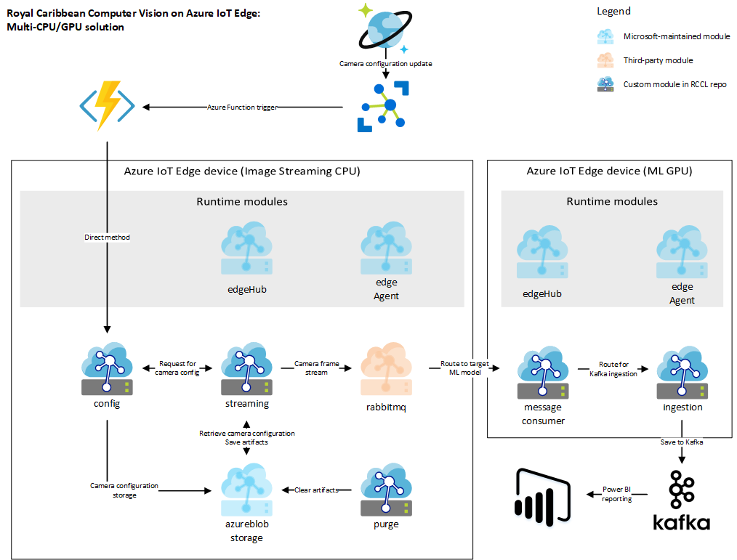
Notes:
Azure IoT Edge allowed much of this to work, dealing with the intermittent connectivity issues so we could concentrate mostly on modeling and building out the on-board infrastructure. If you were to use another technology than Azure IoT, you would need to ensure you could deal with intermittent connectivity, make sure you could store things locally until you were connected and then easily upload them, monitor the situation so you purged local storage as necessary to make sure you didn’t run out of space, etc. We didn’t need to quantize the model in this instance since the local on-ship data center had GPU machines, and connectivity (when it existed) was strong enough to download even large models.

Slide 32

<Redacted>
Notes:
Finally, there are a few other projects we’ve worked on or are currently working on where … we can’t really talk about them in any detail. However, the ones I’ve chosen and the general talking points I’ve covered deal with most of the issues we’ve encountered even in the projects we’re not allowed to talk about.

Slide 33
What’s Next?
Notes:
Lastly, let’s spend a few minutes on what’s next. This space is still evolving, so there is no “right answer” yet – feel free to ignore my advice in this talk, argue with me, and I’ll have time for questions at the end. All I ask is that you don’t blindly accept what I say – the field is moving too fast, anything I say is at best a starting point. I’ll share with you some of my, and more importantly my team’s, thoughts for where the DevOps, IoT Ops, and ML Ops fields are going next.

Slide 34
How DevOps is Evolving
DevOps
Cluster Orchestration
Storage DevOps
IoT DevOps
Edge Clusters
Better Resource Control
ML DevOps
Better separation of concerns
Concept Drift
Notes:
For DevOps, we’re seeing Kubernetes increasingly dominating the landscape, with full cluster orchestration now becoming part of people’s DevOps pipelines (multi-k8s). Storage, always the problem child of any orchestration solution, is gaining support and issues like split-brain and quorum collapse are now mostly just painful memories.
IoT is seeing Kubernetes on IoT devices for Edge cluster coordination, and better solutions for controlling on-device resources both in terms of ML (better model formats for quantization and compression) and more awareness of container bloat and its impact on IoT scenarios.
For ML, we’re seeing better separation of concerns between model training and inferencing, with formats like ONNX and deployment targets like WinML, FPGAs and TPUs. We also see advances in deployed model monitoring, with incorporation of things like concept drift tracking.

Slide 35
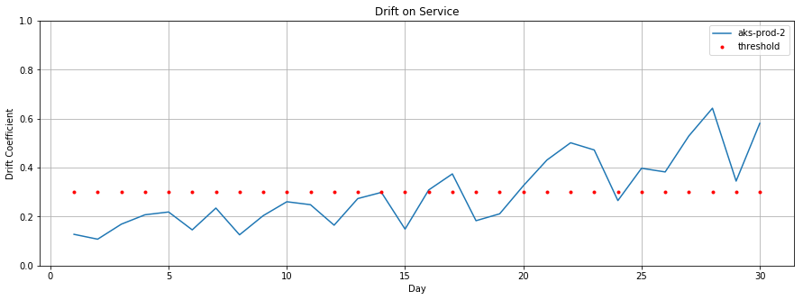
Data Drift
Training Env
Inferencing Env
What is Data Drift
Drift contribution of all features in the model
access to raw training and inferencing data in AML workspace for further debugging
Configurable service with standard distance measures (e.g. Kullback-Leibler, Battacharayata)
When data served to model in prod (inferencing stack) is different from the data that the model was trained on, it is called data drift
Why is Data Drift important
Data drift is one of the top reasons where model accuracy degrades in prod
Time to detect data drift ranges from days to weeks
What can I expect from data drift service
Monitoring of drift through alerts, and visual indicators
Model accuracy has a significant business impact in terms of costs and revenue
Our solution detects concept drift over entire datasets
Model
Training Data
Feedback Data
Data Drift Service
Notes:
Azure ML for instance is starting to incorporate data drift tracking for models, allowing deployed models to determine if the data they see in production differs significantly from the data they were trained on, and alert the data scientist that it might be time to train a new model (and potentially re-evaluate some assumptions).

Slide 36
Useful Resources
DevOps
Azure DevOps, Jenkins, Travis
https://azure.microsoft.com/en-us/services/devops/
https://jenkins.io/
https://travis-ci.org/
IoT Ops
Azure IoT Edge
https://azure.microsoft.com/en-us/services/iot-edge/
Azure IoT Edge AI Toolkit
https://github.com/Azure/ai-toolkit-iot-edge
ML Ops
Azure ML / MLFlow
https://docs.microsoft.com/en-us/azure/machine-learning/service/
WinML / ONNX / ELL
https://onnx.ai/
https://pypi.org/project/winmltools/
https://microsoft.github.io/ELL/
My Team’s Resources
https://www.microsoft.com/developerblog/
https://github.com/microsoft/MLOps
https://mlflow.org/
Notes:
Finally, here are some useful links for things I’ve mentioned in the talk, and I’ll be providing the deck as well (see the footer for the link).

Slide 37
Questions?
I’m Hiring: https://aka.ms/mltjob
Link to this deck: https://aka.ms/mlt2019

